Slide 1


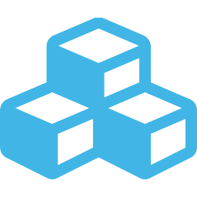




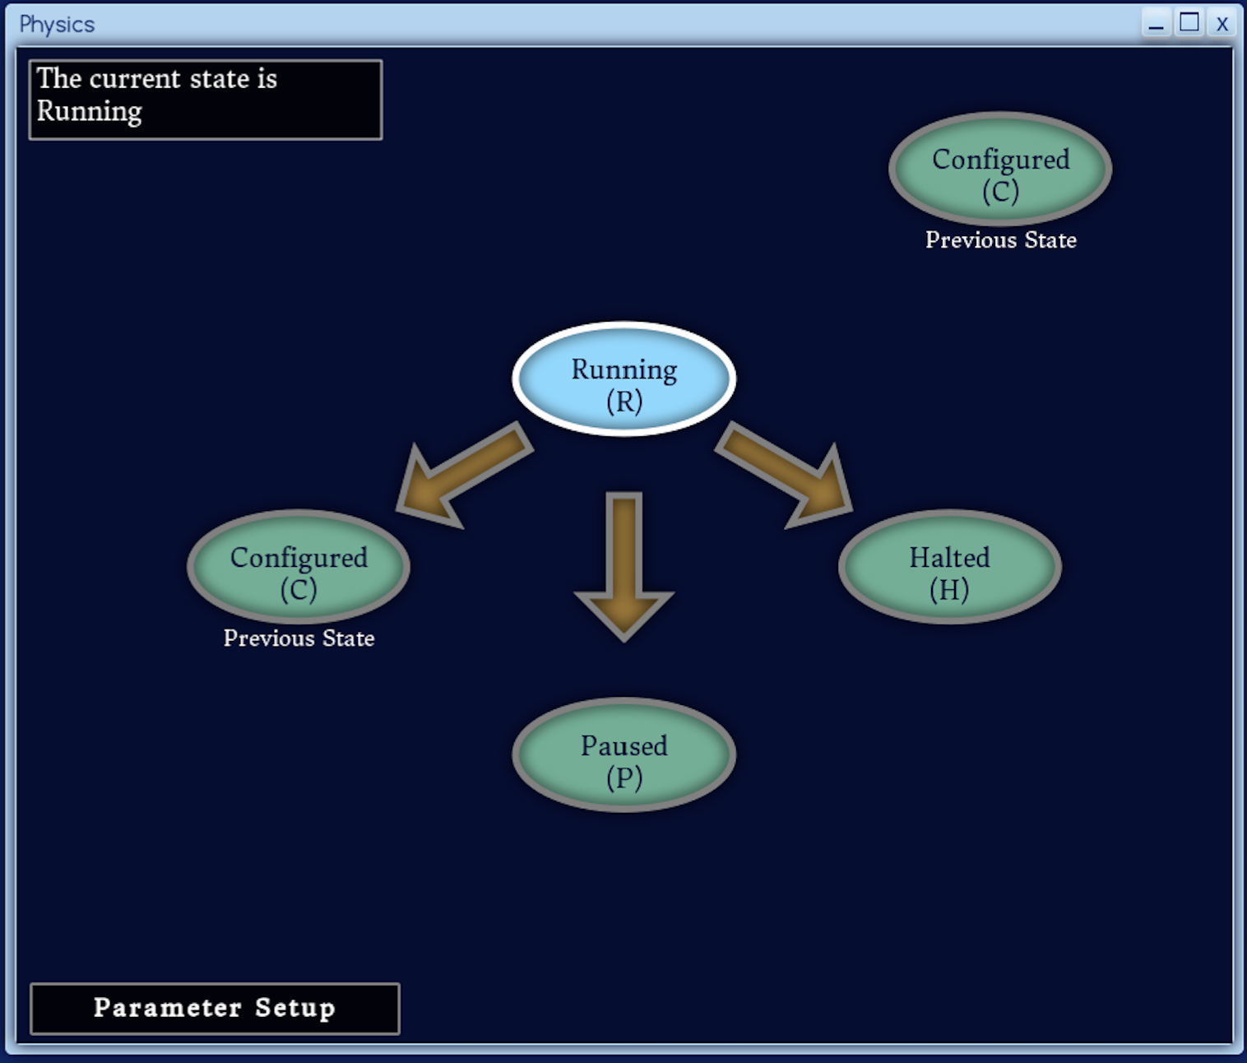
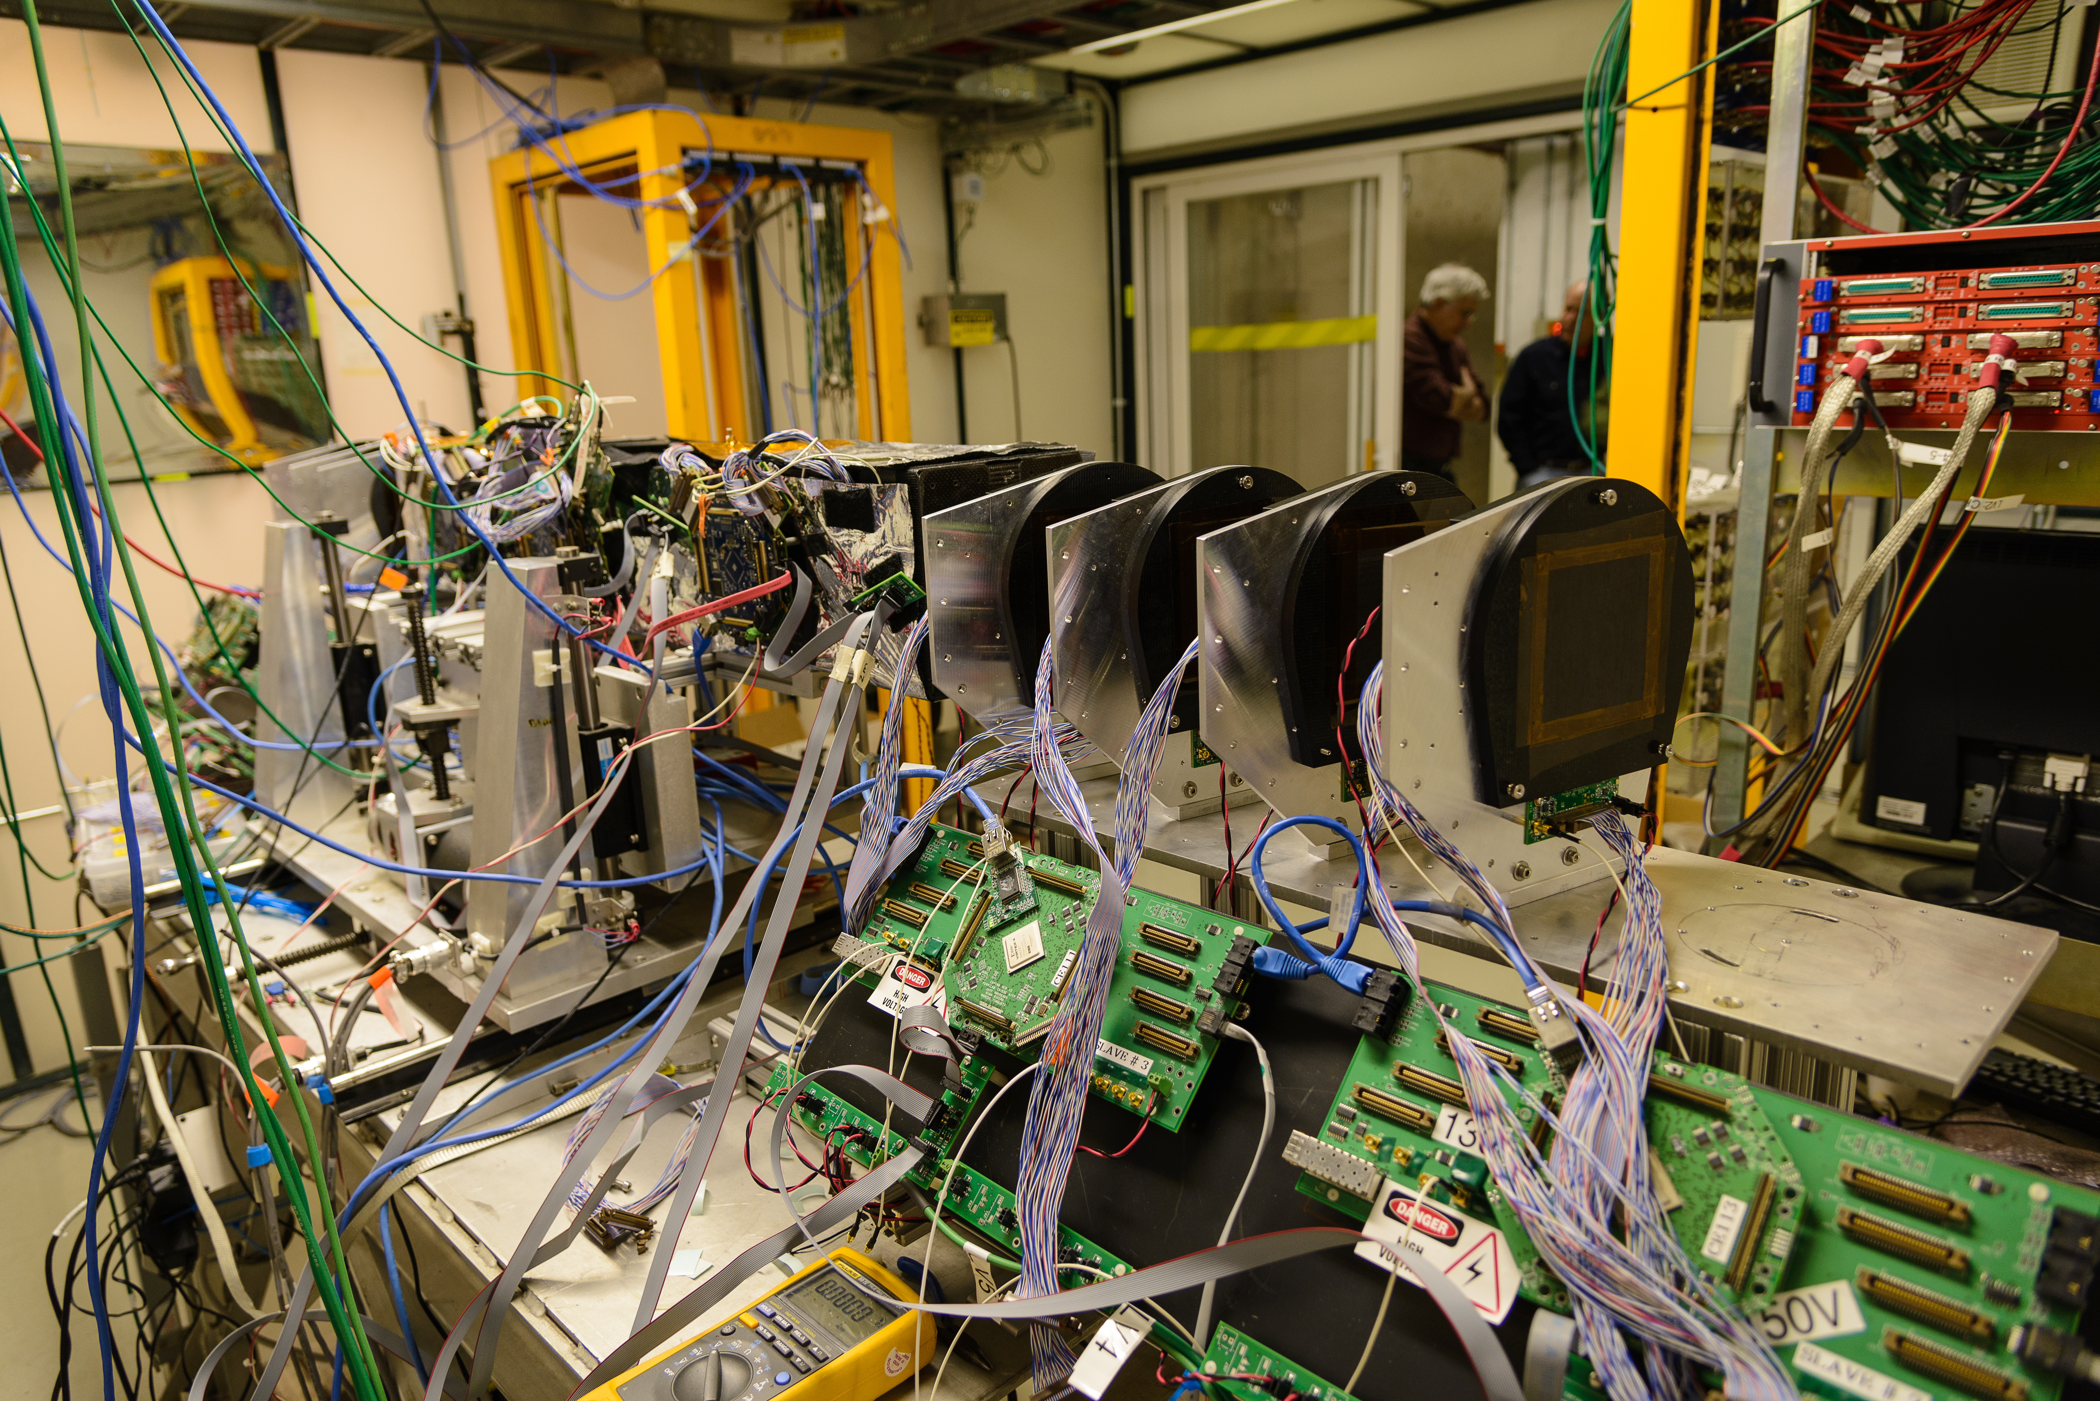
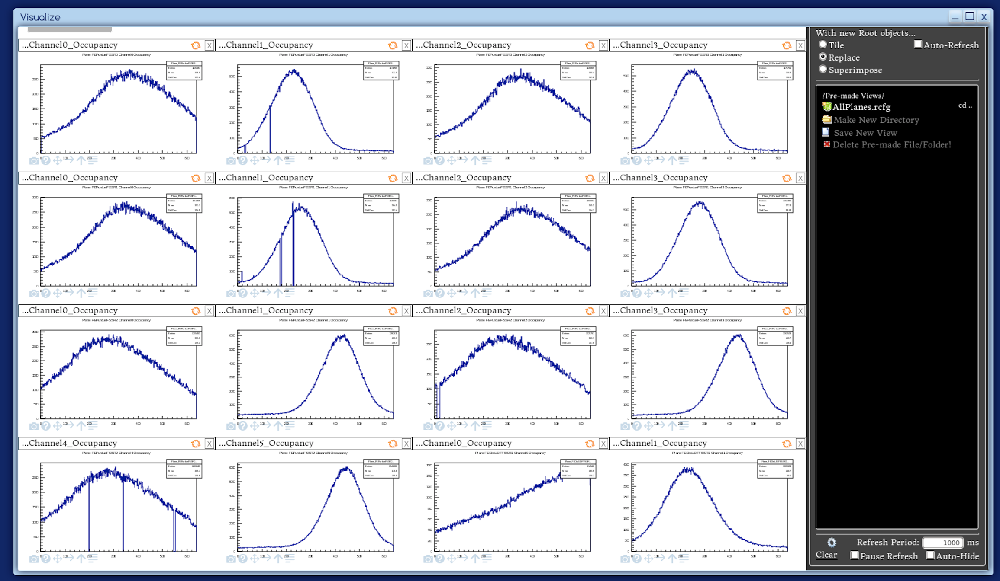
otsdaq for Test Beam Infrastructure
Preston Hansen, Kurt Biery, Mark Bowden, Eric Flumerfelt, Ethan Lewis, Gennadiy Lukhanin, Daniel Parilla, Alan Prosser, Ron Rechenmacher, Ryan Rivera, Lorenzo Uplegger, Sijia Wu (FNAL)
Introduction to otsdaq
Abstract
The Real-time Systems Engineering Department of the Scientific Computing Division at the Fermi National Accelerator Laboratory is in the process of integrating the instrumentation of the Fermilab Test Beam Facility into a common framework. Using otsdaq (Off-the-Shelf Data Acquisition System), a highly-scalable flexible data acquisition system, facility instrumentation, (such as scintillator coincidence logic, wire chambers, Cherenkov detectors and the precision silicon tracking telescopes) could be connected using an Internet of Things style architecture united by the software framework provided by otsdaq. An open source library of configurable firmware blocks are provided as part of otsdaq to facilitate development with hardware, and the library can be contributed to by the otsdaq user community. otsdaq offers a platform-independent graphical user interface implemented with HTML5 and JavaScript which can be simultaneously accessed by multiple users through a web browser on any device. User interfaces for otsdaq are built on top of XDAQ, a generic data acquisition framework developed for the CMS experiment, and the data transfer and online analysis are based on artdaq, a data acquisition toolkit developed at Fermilab. This paper will discuss results from the initial integration of otsdaq into the Fermilab Test Beam Facility highlighting the flexibility and scalability of otsdaq.
otsdaq at the Fermilab Test Beam
otsdaq provides scalable, low-cost data acquisition architecture as a service
The Fermilab Test Beam Facility is an environment where otsdaq is effective, since test beam users face particular challenges
Users are given a coherent hardware and software package, eliminating the need to evaluate the myriad of available options
otsdaq lets physicists do physics, not reinvent the (DAQ) wheel.
Users have only 1-3 weeks to accomplish their project goals
Experts may not be available or may only be available remotely
Typically only a few members of a project are on shift at the test beam at a given time, so personnel availability is limited
Front end electronics
otsdaq web GUI
Online processing
otsdaq addresses many of the primary challenges that users of a test beam environment face
Network
otsdaq saves precious time by allowing users to validate the functionality of their interface prior to the test beam via a generic hardware emulator
Collaborative features like chat, logbook, and user accounts in the otsdaq web interface allow remote users to communicate effectively
otsdaq developers are available as a resource to help ensure functionality of a project’s specific DAQ solution at the Fermilab Test Beam Facility
storage
Using otsdaq: run control
Integrating otsdaq at the test beam
otsdaq is now used for readout and control of the FTBF silicon strip high resolution particle tracking telescope.
Users implement the run-control states for their interfaces: Initialize, configure, start, stop, halt,
then use the web GUI to control their DAQ!
The silicon strip telescope at FTBF
Real-time jsROOT visualization of the beam profile

